Slide 1
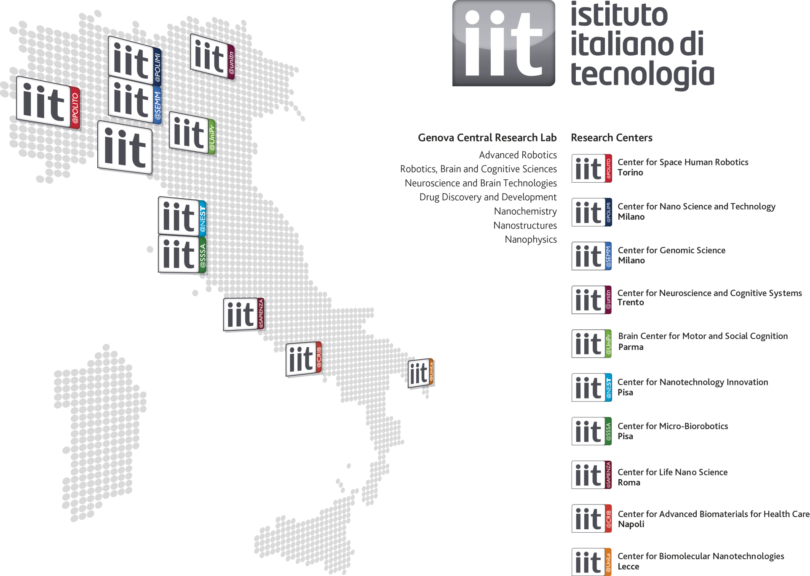
PAVIS
iCub Facility
+ IIT@Harvard
+ IIT@MIT
1220 people, from 50 countries, 42% foreign, 85 EU projects, 180 patents, 10 start-up
1

Slide 2
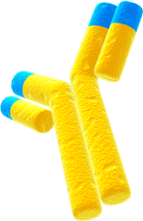
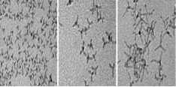
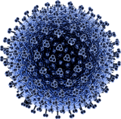
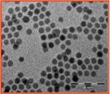
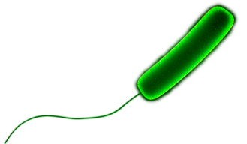
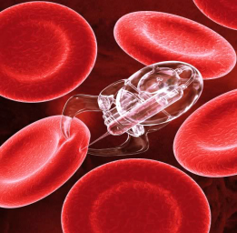
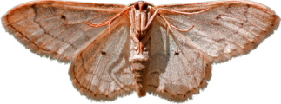
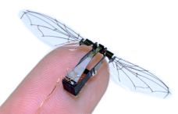
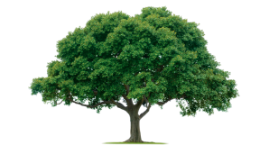
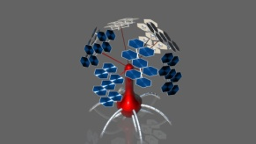
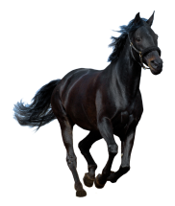
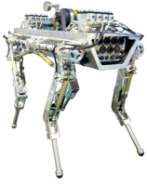
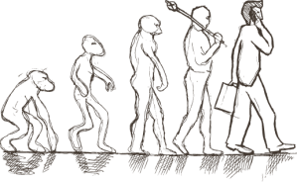
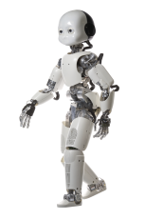
The hardware approach
Biochemical Robots
Antibody
1nm
Intelligent
Nanoparticles
Colloidal Chemistry
Biochemical Recognition
Drug Delivery
Cell Operation
Virus
20-250
nm
Clusters of
Nanoparticles
Bio Functionalization
Bio Repair
Diagnostics (Passive)
Bacteria
μm
Micro
Robots
Bio Factories
Micro-Hospital
Diagnostics (Active)
Micro Mechanics
Mechanical Robots
Insect
Soft, lightweight
Nanomaterials
Swarm Intelligence
Scale of Complexity – Architecture
Miniature
Robots
High Precision
Actuation Applications
mm
cm
dm
Plants
Chemical sensing
Soft materials
Advanced
Mechatronics
Exploration
Space
Cognitive
Horse
Cognition/Learning
Batteries
High Power
Augmented Performances
Advanced Sensors
Motors, Devices
Service
Heavy Duty
Applications
m
Human
Creativity
Understanding
Emotion
Natural Interaction
Artificial Human
Hostile Environments
Robot Companion
Social Robots
Humanoid
Technologies

Slide 3

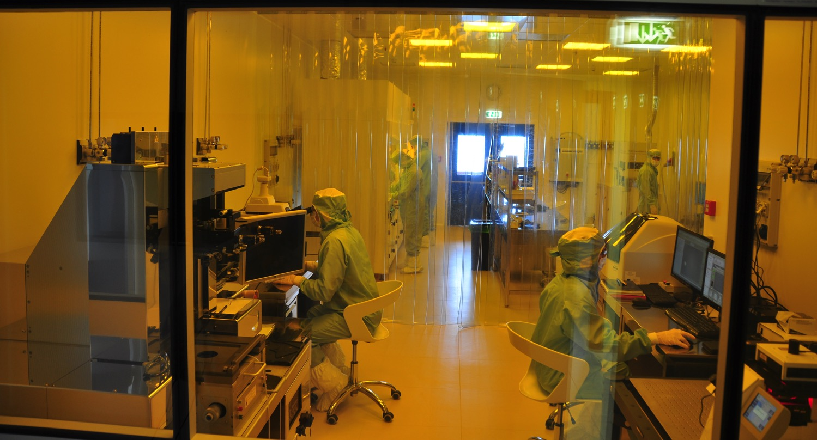
Centro per le nanotecnologie biomolecolari
Massimo De Vittorio

Slide 4
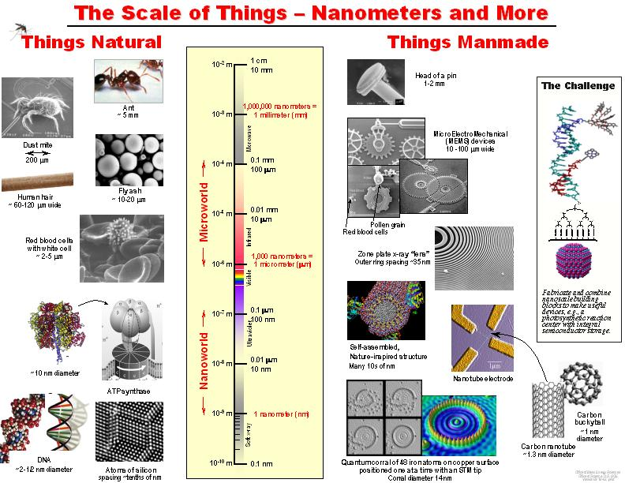
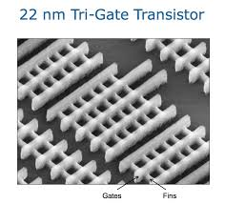
LA SCALA DELLE COSE – MICRO E NANOTECNOLOGIE
COSE NATURALI
COSE FABBRICATE DALL’UOMO
Dust mite
http://apod.nasa.gov/apod/ap140112.html

Slide 5
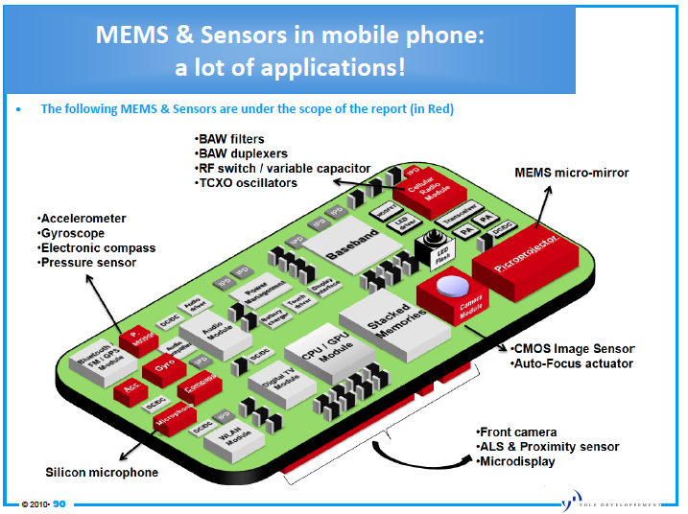
Nanotecnologie negli smartphone
Memoria

Slide 6

1 transistor è lungo 22 nanometri
1 bit di memoria richiede almeno 2 transistor
1 byte = 8 bit
quanti transistor servono per una memoria di 16 Gbyte?
128 miliardi di transistor

Slide 7
le nanotecnologie richiedono ambienti controllati
pochissime particelle di polvere
temparatura ed umidità costanti
luce gialla

Slide 8
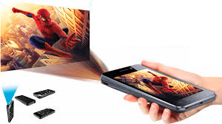
PROIEZIONE

Slide 9
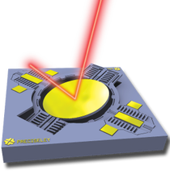

PROIEZIONE

Slide 10
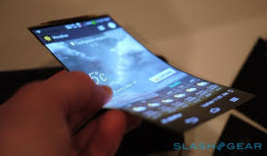
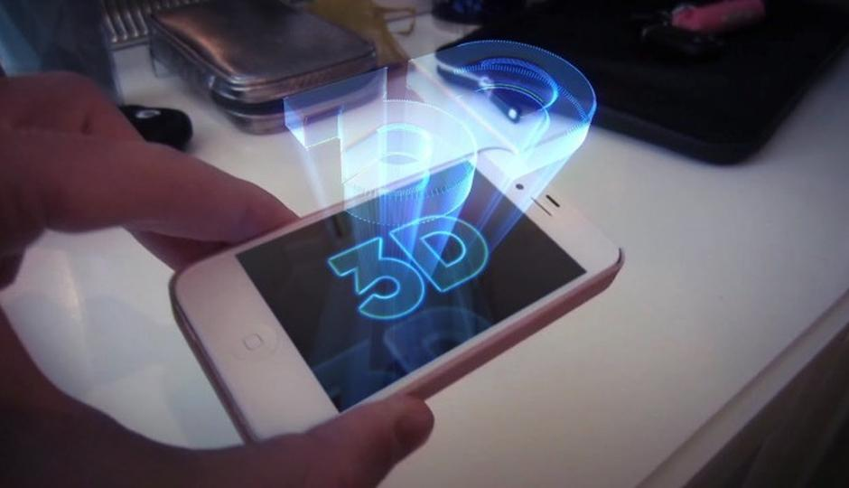
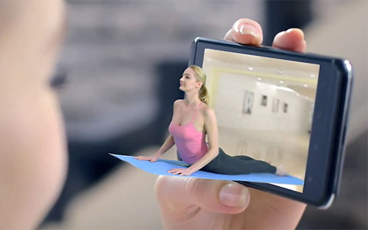
PROIEZIONE
SCHERMI FLESSIBILI
OLOGRAMMI 3D

