Slide 1
Tailspin Toys
Fall Additions to Our Product Line

Slide 2
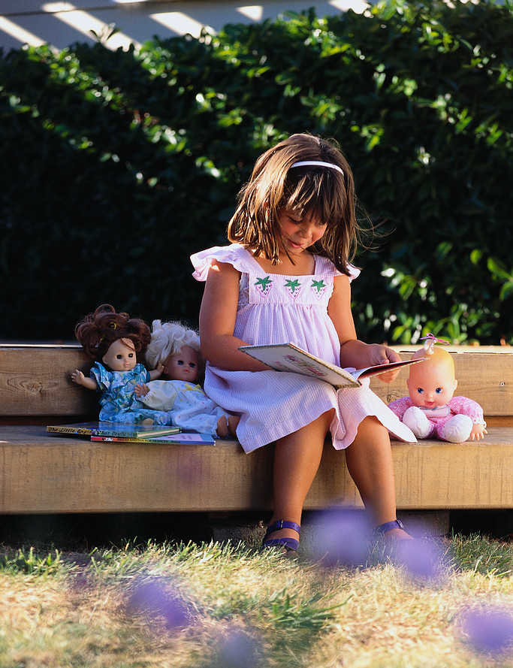
The “Read-to-Me Gang”
Selection of six dolls (sold individually)
Each doll has its own story book
Features ideas to help kids create their own story books
Male and female
List price: $14.99

Slide 3
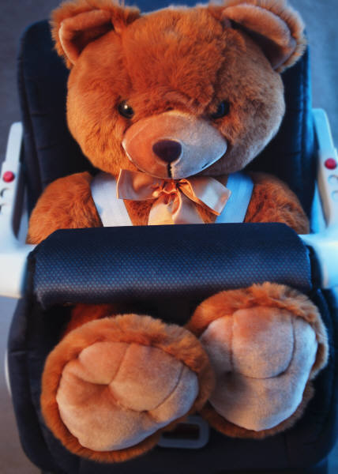
“Rory the Safety Bear”
Plush, stuffed bear
Suitable for toddlers
Comes with his own car seat
Says eight different safety tips
Non-toxic, flame-resistant

Slide 4
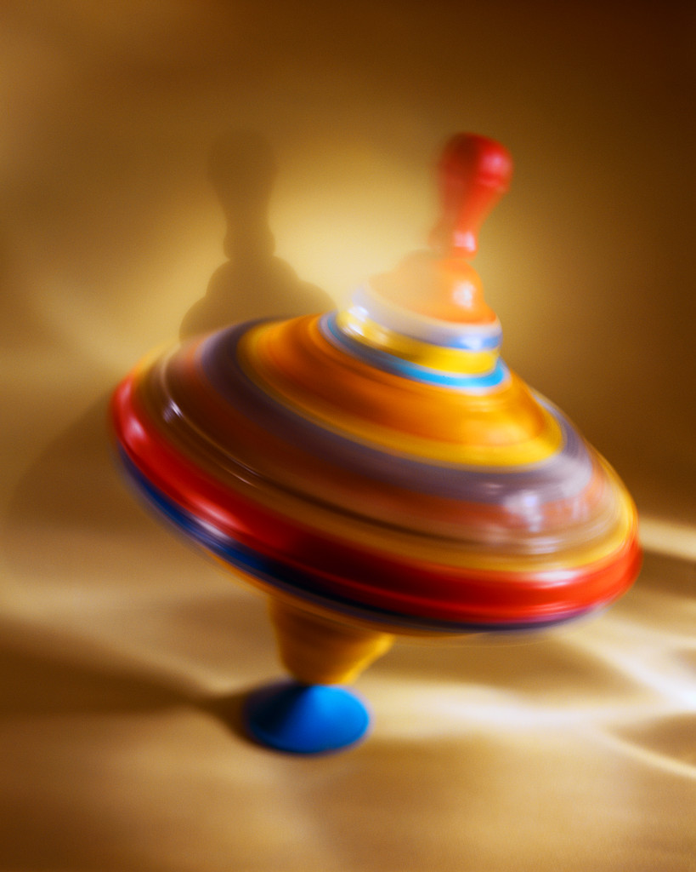
“Dizzy Lizzy”
The world’s fastest top: 800 RPM!
Randomly plays six different songs
Suction-cup stand for “play anywhere” action

