Slide 1
Lecce - DAQ per ITk-pixel
Roberto Assiro,
Gabriele Chiodini,
Rita Coluccia,
Pietro Creti,
Luigi Longo,
Alessandro Miccoli,
Alessandra Palazzo,
Antonio Pellegrino,
Carlo Pinto,
Enrico Junior Schioppa,
Stefania Spagnolo

Slide 2
Goals
General:
We are a half-ring loading site => in production mode we need to be able to
Perform module reception tests (electrical and visual)
Perform electrical multi-module tests post-loading
with DAQ/DCS for typical system-tests (a la SR1 and integration tests)
Cooling via half-ring cooling system => CO2 based - Marta
With serial powering
Before/after thermal cycling the loaded half-ring (subject to the definition of the ATLAS wide QC procedures
Get and store data of all component to ATLAS production DB
On the time scale of the local support FDR (Fall 2022):
We aim to demonstrate the ability of testing (a few digital) modules loaded on a prototype local support, hosted in the test-transport box (as ready for shipping to the integration site) exercising DAQ/DCS/Cooling/Interaction with DB as in “production mode” (i.e. demonstrating readiness of all needed infrastructures)

Slide 3
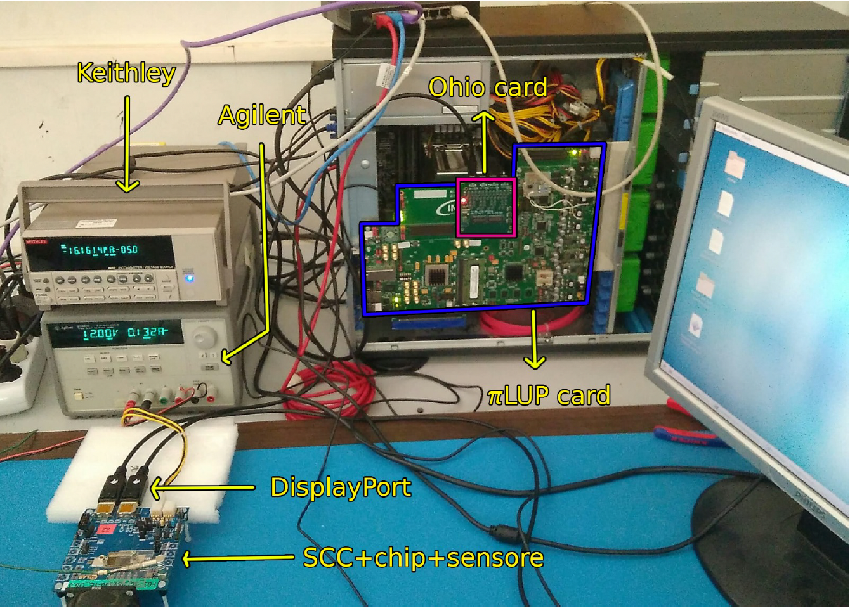
What we did so far
In Feb 2020, we took part in the traveling chip pixel-wide exercise:
Lecce report (on chip 3, 0x495) is linked at the corresponding entry here: https://twiki.cern.ch/twiki/bin/viewauth/Atlas/ContactDetails
The setup consists in
1) DAQ board: πLUP, developed for TDAQ studies in BO (A. Gabrielli et al) instead of the typical YARR board, but featuring the same FPGA and general features;
it requires a slightly modified firmware w.r.t. typical fw of YARR setup (thanks to K. Naoki)
2) SCC
3) DAQ sw YARR
4) Standard LV power supplies and Picometer
the setup

Slide 4
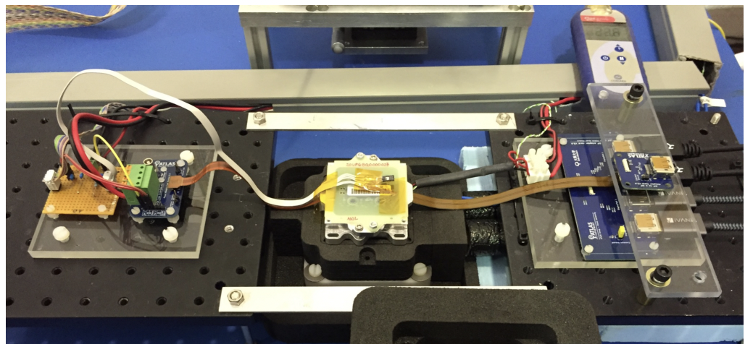
What we did so far
June 1st 2021, Lecce (as loading site) qualified for the module reception tests presenting results of tests on a digital module (link to the slides: https://indico.cern.ch/event/1044649/contributions/4389089/attachments/2256176/3828386/2021-05-25_digitalQuad_testLecce.pdf)
In practice demonstrating the same ability of performing electrical tests as module production site (same equipment)

Slide 5
What we did so far
June 1st 2021, Lecce (as loading site) qualified for the module reception tests presenting results of tests on a digital module (link to the slides: https://indico.cern.ch/event/1044649/contributions/4389089/attachments/2256176/3828386/2021-05-25_digitalQuad_testLecce.pdf)
In practice demonstrating the same ability of performing electrical tests as module production site
we were provided the same test equipment as module production sites):
A digital quad module + interface card for 4chip data to DAQ + power distribution + temperature sensing card
We used the same DAQ system (πLUP based), YARR software and we exercised access to the production DB / writing to the local DB
DCS (see Gabriele slides)
Successful scan (digital, analog, threshold, noise) and tuning (threshold & time over threshold) of all 4 chips

Slide 6
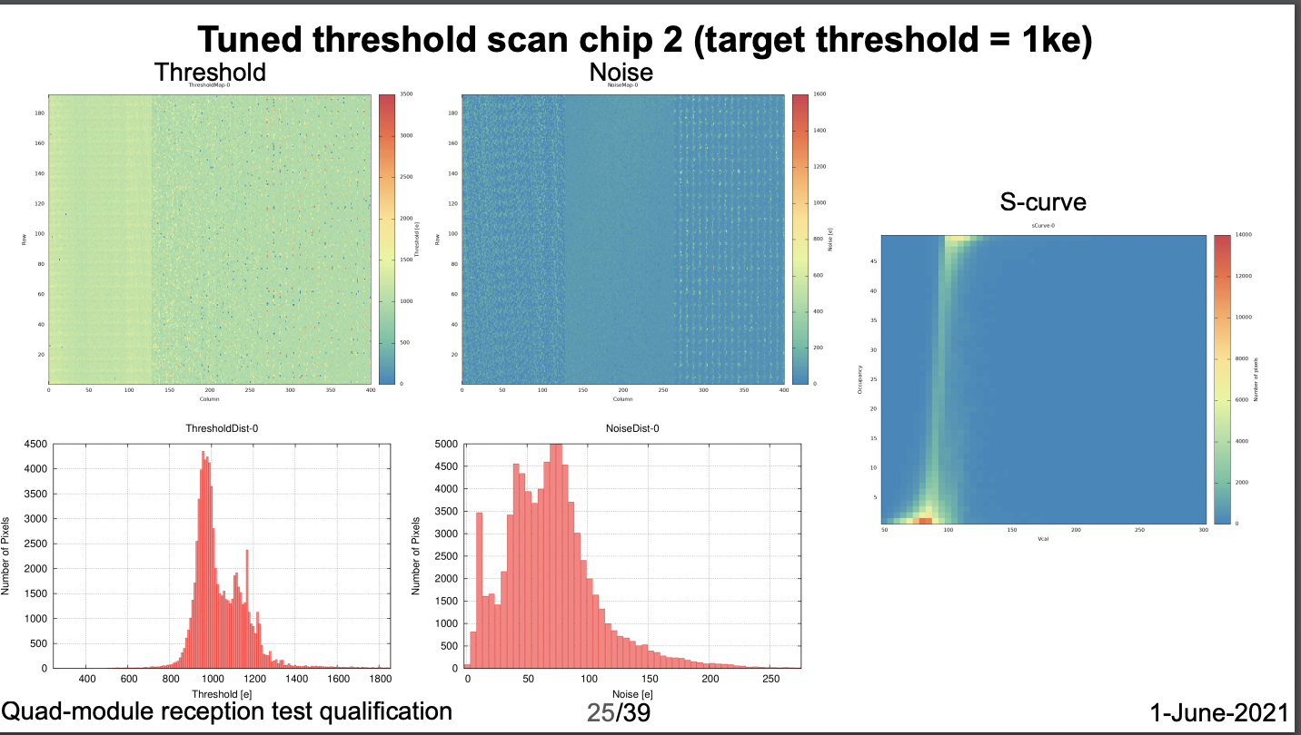
What we did so far
Some example plot

Slide 7
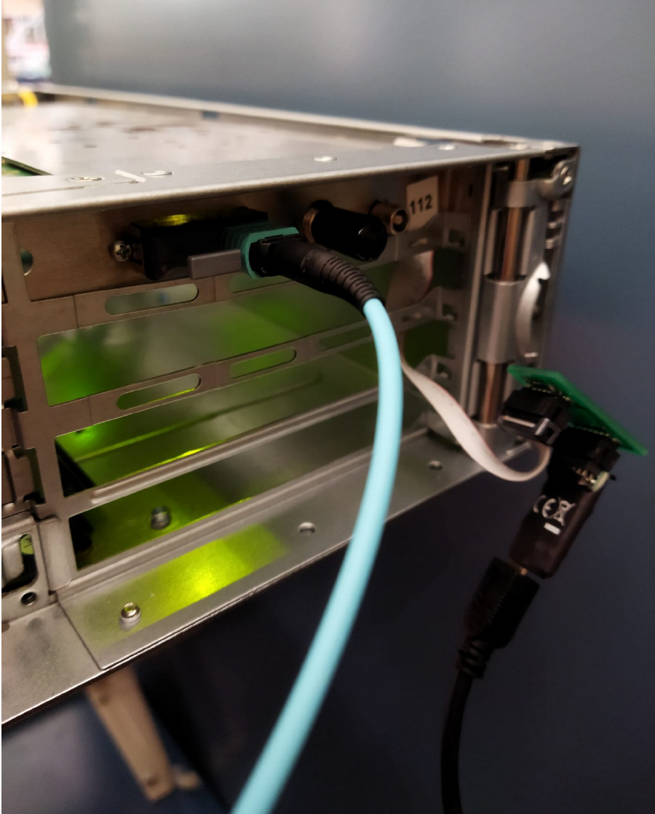
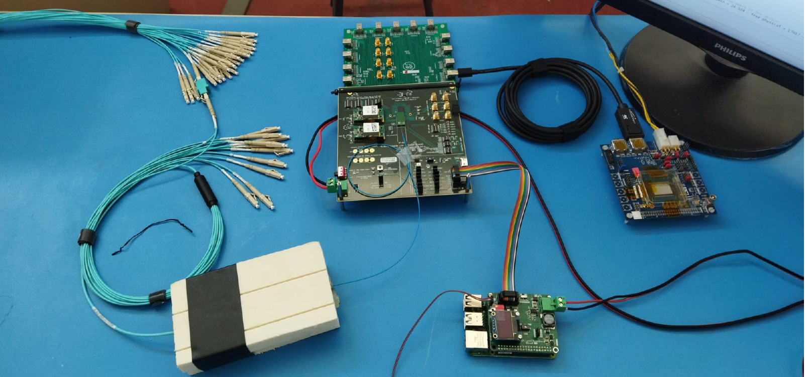
These days
Moving electrical tests to a Felix-based setup
Felix code from TDAQ -> Felix core + Netio
Readout DAQ
Yarr
Itk-felix-sw (TDAQ integrated): https://gitlab.cern.ch/itk-felix-sw/RD53Emulator
In fast evolution
to be replaced by optobox in the near feature
Server with FLX712 board
24x MPO bundle
Optical fibers
Optical fibers to LpGBT
VLDB+ and its controller
Single chip card
Apparently everything ready to run scan procedures, but not yet pixel hits read back

Slide 8
Next steps - toward local support FDR
Having the Felix setup working
And it’s evolution with the optobox
Integrating readout software with DB (done for module testing)
Prepare for serial powering, as soon as prototype components are available
Prepare for data transmission from module via production pigtails / interface cards
Exercising DAQ / DCS communication:
Following starting effort of prototyping DDC following ATLAS design and (ITk pixel) requirements at SR1 (A. Palazzo + SR1 daq/dcs team)
See https://indico.cern.ch/event/1160515/contributions/4884423/attachments/2447974/4194837/DAQtoDCScommuncation_May20.pdf

