Slide 1
Produzione anomale di VV e VH ANA-HDBS-2020-05
Lecce (unico gruppo INFN coinvolto)
M. Centonze,
G, Chiodini,
A. Palazzo,
E.J. Schioppa,
S. Spagnolo

Slide 2
Premessa
La presentazione piu’ recente che riassume lo stato generale dell’analisi e’ qui
https://indico.cern.ch/event/1155003/contributions/4849582/attachments/2446423/4192328/VVVHSemilepStatusReport.pdf (Yassine El Ghazali) al meeting generale del w.g. DBL (DBL Subgroup Meeting) del 18 maggio
https://indico.cern.ch/event/1155003/
Da Glance: ANA-HDBS-2020-05
Second iteration of the search for VV and VH resonances in semileptonic final states, exploiting the synergy between the two decay modes, using improved analysis techniques (qg-tagging, boosted Z->ee tagging, more sophisticated MVAs), inclusion of VBF mode, and additional interpretations (ALP, non-resonant)
Pubblicazioni del 1st round:
HDBS-2018-10 DBL - VV semileptonic pubblicato su Eur. Phys. J. C 80 (2020) 1165
Search for heavy diboson resonances (WW, ZZ, WZ) in semileptonic final states in $pp$ collisions at $\sqrt{s}=13$ TeV with the ATLAS detector [intera stat del run2]
Lecce + Napoli; tesi di PhD di A. Giannini e M. Lavrogna (NA)
HDBS-2020-19, DBL - VH semileptonic [intera stat del run2] draft ATL-COM-PHYS-2021-362
2nd circulation appena conclusa (7 Giugno) - no gruppi INFN coinvolti
Lecce
2022-06-15

Slide 3
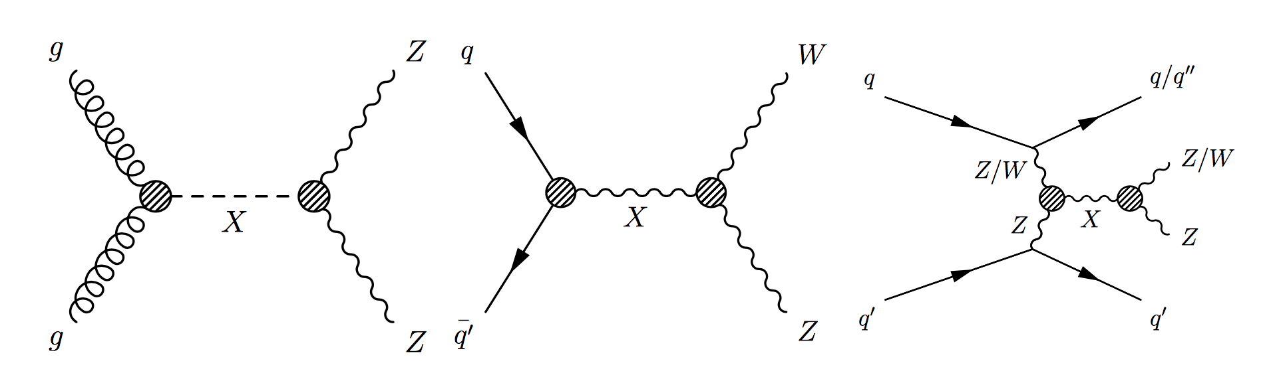
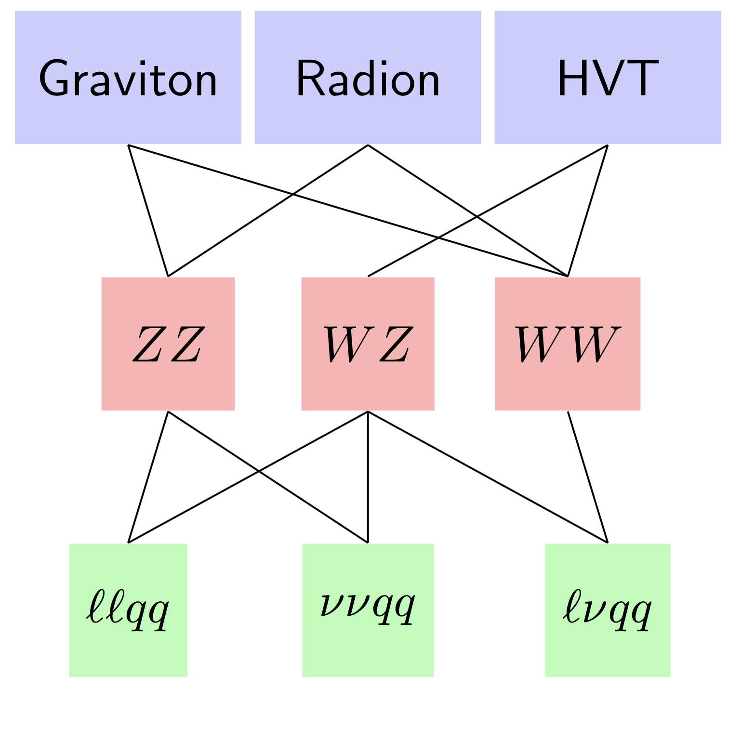
ANA-HDBS-2018-10
1st round resonant VV
L= e,μ
Search for X -> VV-> 0L, 1L, 2L
+ 1 large-R jet (merged regime, powerful at high X mass ) OR
+ 2 jets (resolved regime, except for the 0L channel)
Two topologies for X production mechanisms investigated separately
quark-antiquark annihilation or gluon-gluon fusion and vector boson fusion
event classification with a RNN developed for this analysis
Three model classes for interpretation:
spin 0 (RS Radion), spin 1 (W’, Z’ in HVT), spin 2 (RS graviton)
Selection (in addition to leptonic V):
(pT dependent) mass cuts on hadronic V [ + jet substructure in the merged regime ] define low-purity and high purity SRs, in some cases separated further based on the hadronic V being reconstructed from b-tagged jets or not
Z+jets, W+jets and top control regions to define the normalisation of the main backgrounds depending on the leptonic channel
ggF
qqA
VBF
Lecce
2022-06-15

Slide 4
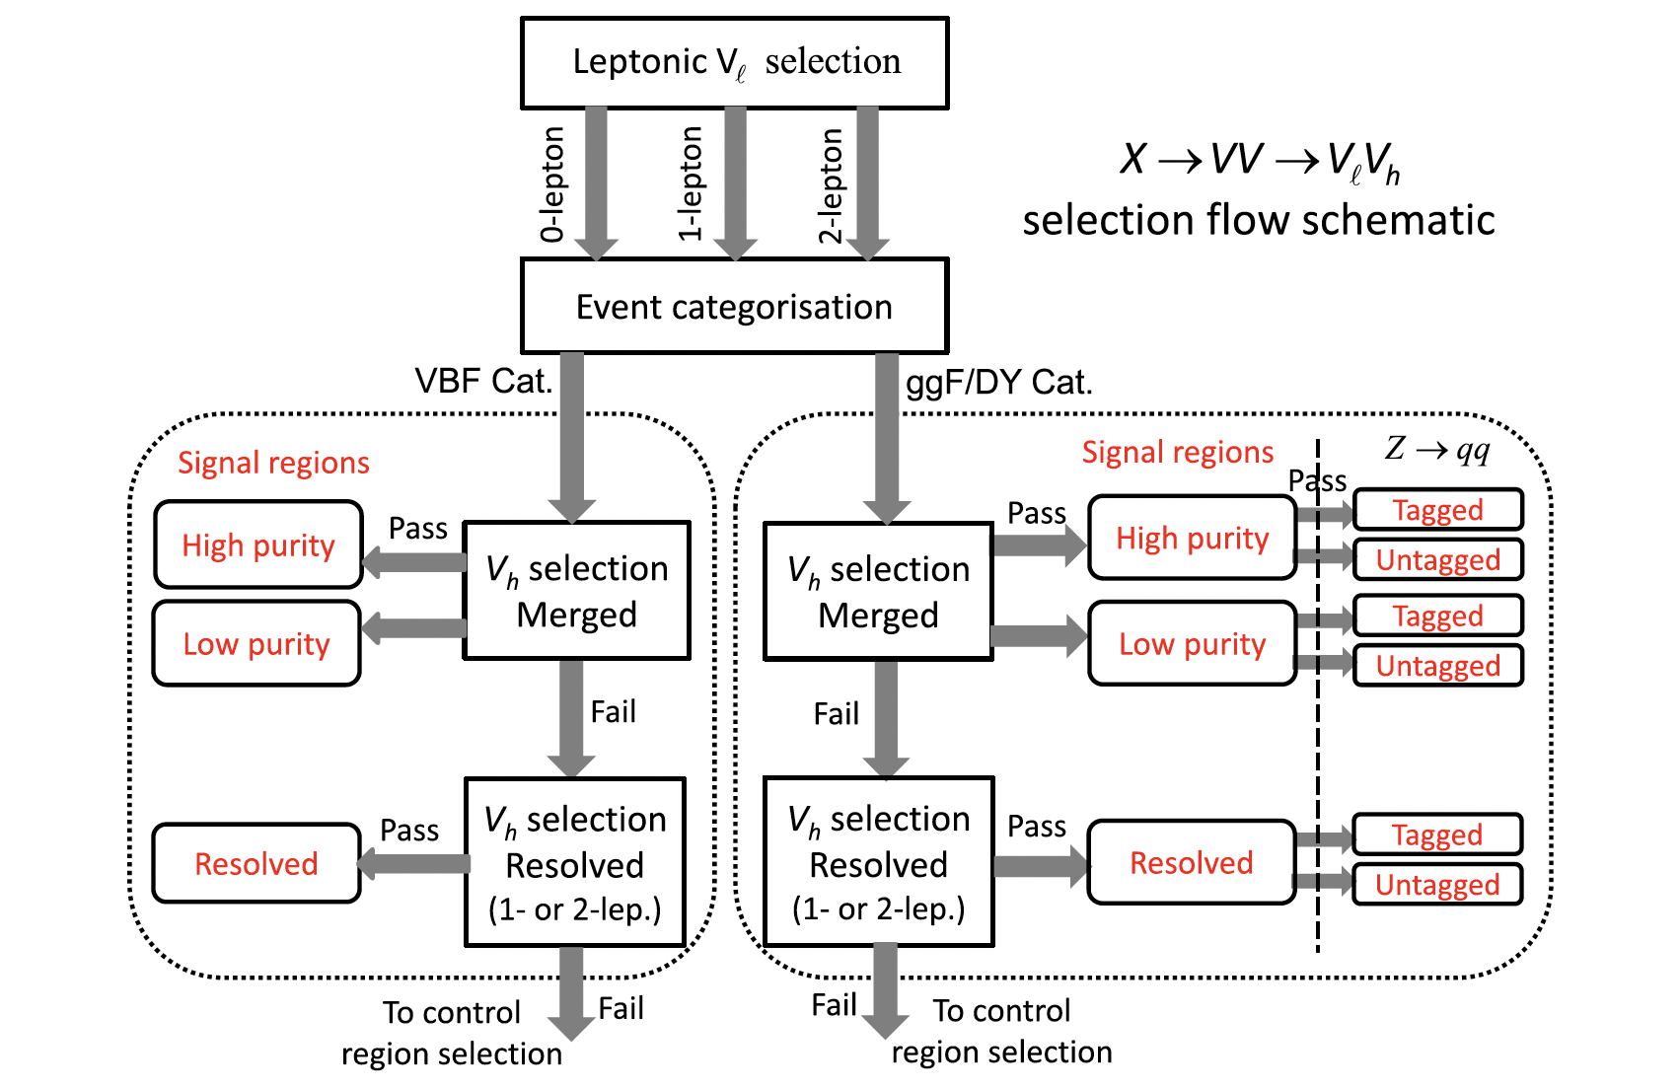
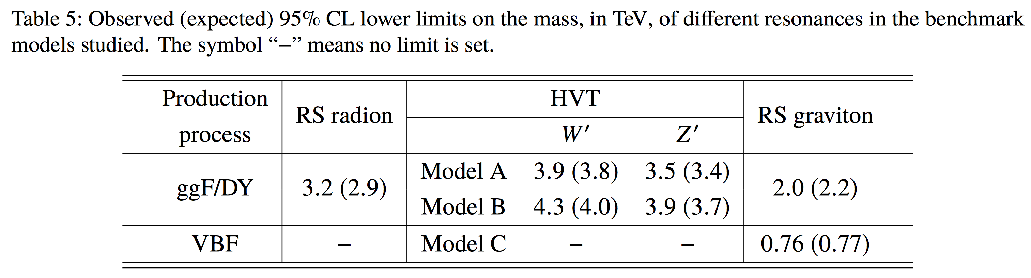
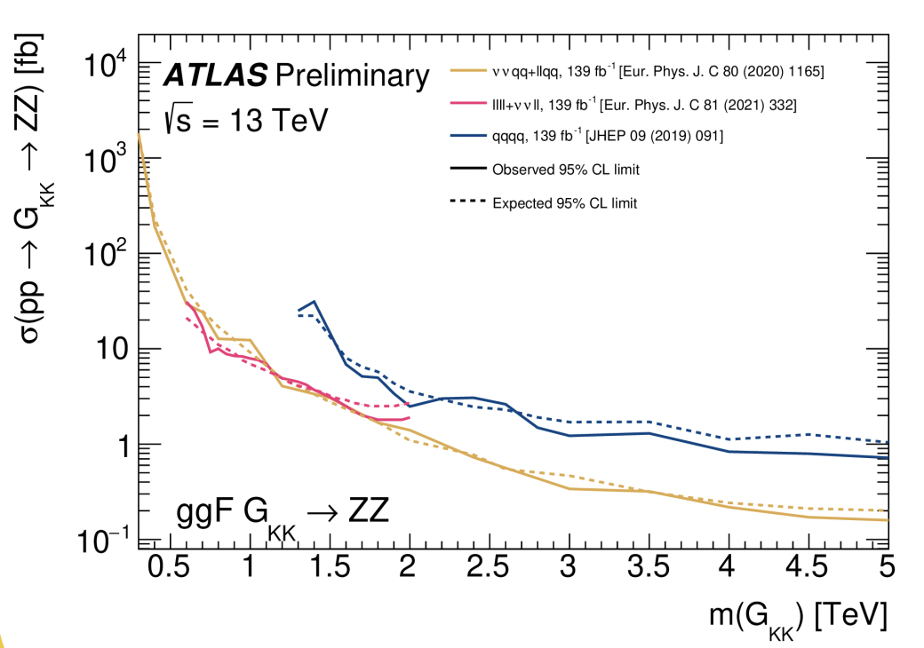
ANA-HDBS-2018-10
A complex flow: for example, 9 SR for ZZ interpretation on the 2L channel (!)
mllJ or mlljj as signal / background discriminant
Jets: TCC large-R jets, EMTopo, VR track-jets for b-tagging of large R jets; MVC2c10 b-tagging
Standard CP recommendations for 1st round full stat Run2 analyses
ATL-PHYS-PUB-2021-018
June 2021
The power of the semileptonic channel
Lecce
2022-06-15

Slide 5
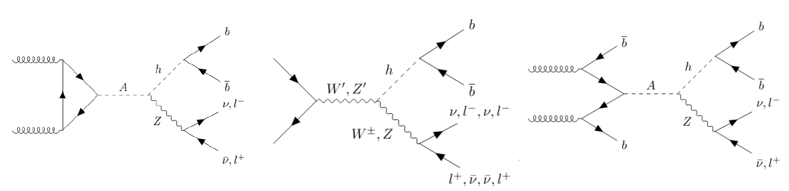

ANA-HDBS-2020-19
1st round resonant VH
L= e,μ
Search for X -> VH-> 0L, 1L, 2L + bb
merged regime OR resolved regime
Two classes of production modes
quark-antiquark annihilation or gluon-gluon fusion and b-associated production
Two model classes for interpretation:
spin 1 (W’, Z’ in HVT)
CP-odd spin 0 A->Zh in 2HDM (type I-IV)
Selection (in addition to leptonic V):
mass cuts on hadronic V + 1b, 2b, >=3b
Control regions with mass sidebands (W/Z+jets) or eμ leptonic selection (top-CR)
Jets and b-tagging like ANA-HDBS-2018-10
ggF
qqA
b-associated prod.
2HDM
HVT
A
Z’
W’
llbb
vvbb
Zh
Wh
lvbb
Gain in 2nd round
Very similar structure of the
VV and VH analyses
Common weakness points (for example low selection eff. of e-channel at high pT)
Shared strategies, solutions, improvements, new jets (flow and UFO) and b-tagging (DL1R)
ML for large-R jet classification
(h->bb, W/Z,, top, background), improved efficiency for Z->ee ,
Parametric DNN for mass interpretation
Lecce
2022-06-15

Slide 6
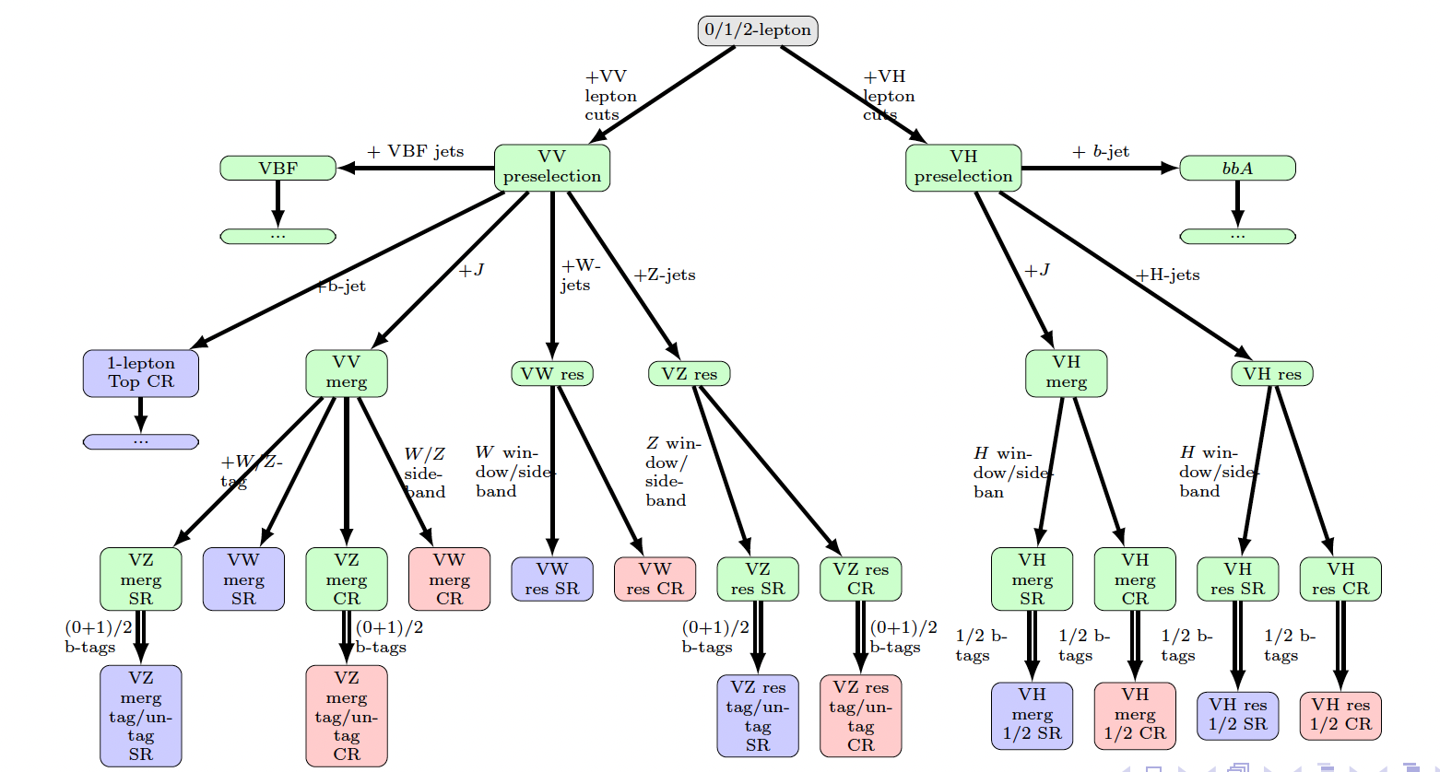
ANA-HDBS-2020-05
2nd round resonant (and non resonant) VV and VH
L= e,μ
Very similar structure of the VV and VH analyses
Common weakness points (for ex. low selection eff. of e-channel at high pT)
Shared strategies, solutions, improvements, new jets (particle flow and UFO) and new b-tagging (DL1R)
Extended use of ML:
for large-R jet classification (h->bb, W, Z, top, QCD)
improved efficiency for Z->ee
Parametric networks with parameter = X mass
Use RNN in VH
EFT interpretation
Several operators affecting VV and V+jets
Strategy discussed with theoreticians and ATLAS wide EFT interpretation fora
To be used to make orthogonal VV and VH channels + to suppress background
Analysis flow
VV
VH
Lecce
2022-06-15

Slide 7
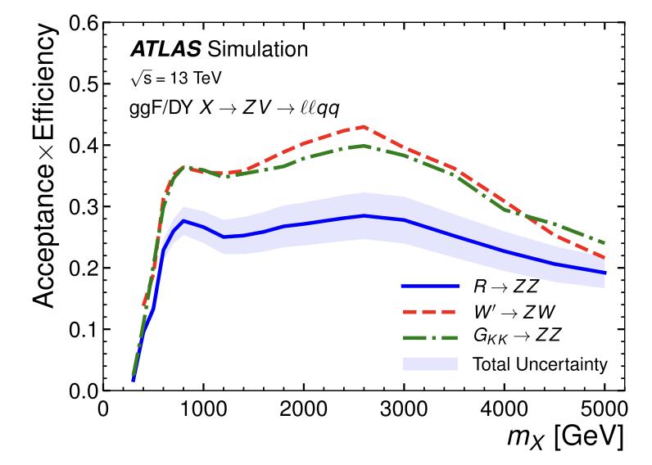
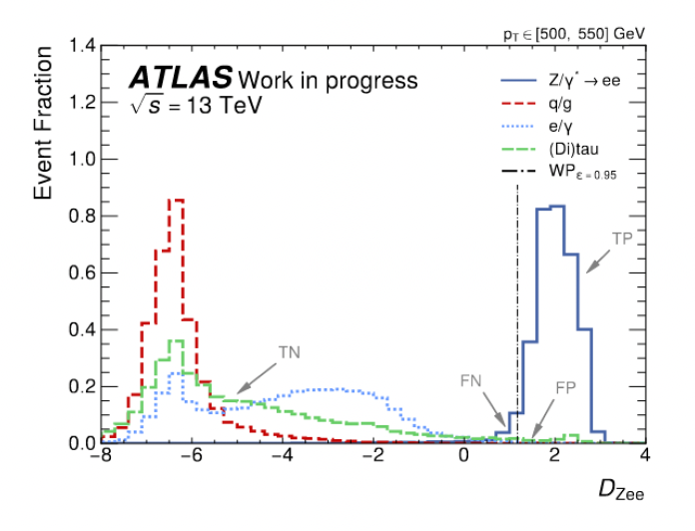
ANA-HDBS-2020-05
ANA-HDBS-2018-10
Willing to cure the decrease in efficiency at large pT in the 2L channel due to merging e.m. showers in the calorimeters
Z -> ee tagger
Reconstruct overlapping electrons as small-R jets
NN trained on jet kinematics and other properties; the output probabilities of ee, e/γ, QCD, tau are combined in a discriminant
Very good separation
Lecce
2022-06-15

Slide 8
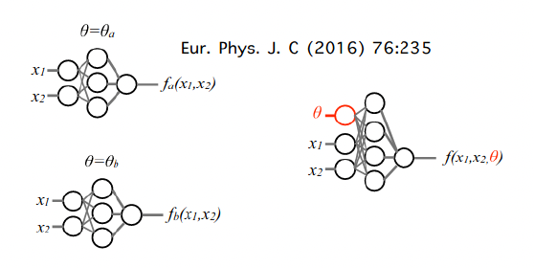
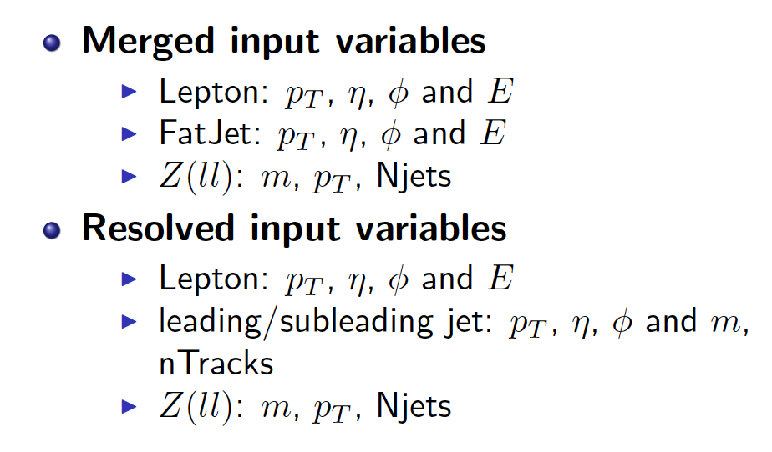
ANA-HDBS-2020-05
ANA-HDBS-2018-10
supporting note
Improve signal / background separation going beyond mll+hadronic V
Parametric DNN (Lecce and Tong )
Explored already for ANA-HDBS-2018-10 (D. Backas [Lecce] & al)
Discriminant from NN replaces mll+hadronic V in signal fit
Approach used in several analyses by now:
For example HH->bbττ
Input
Parameter: mX
Gain: improved sensitivity, no need to train N networks for N mass points
ML cost: background shape depends on mX hypothesis under test
Lecce
2022-06-15

Slide 9

ANA-HDBS-2020-05
Improve signal / background separation going beyond mll+hadronic V
Parametric DNN (Lecce and Tong )
Explored already for ANA-HDBS-2018-10 (D. Backas [Lecce] & al)
Discriminant from NN replaces mll+hadronic V in signal fit
Ongoing studies:
Optimize selection of training set vs statistics;
Optimize set of input variables (low level, mix of low level + high level)
Extend set of input variables
using extended tagger output/input variables
extra event objects
Optimize DNN architecture (how deep ?)
Establish gain in expected limits
General timeline
New production of CxAOD just ready with new variables, allowing for combined VV+ HV studies, harmonization, optimization
6,8 months to EB request foreseen
Lecce
2022-06-15

